Slide 1
Date : 2012/09/20
Author : Sina Fakhraee, Farshad Fotouhi
Source : KEYS’12
Speaker : Er-Gang Liu
Advisor : Dr. Jia-ling Koh

Slide 2
Outline
Introduction
DBSemSXplorer’s System Architecture
Relational database to RDF
Knowledge Base
Extracting an ontology from the database schema
Query Keyword to Knowledgebase Resource Mapper
Keyword mapping Techniques
SPARQL Query Construction
Experiment
Conclusion

Slide 3
Outline
Introduction
DBSemSXplorer’s System Architecture
Relational database to RDF
Knowledge Base
Extracting an ontology from the database schema
Query Keyword to Knowledgebase Resource Mapper
Keyword mapping Techniques
SPARQL Query Construction
Experiment
Conclusion

Slide 4
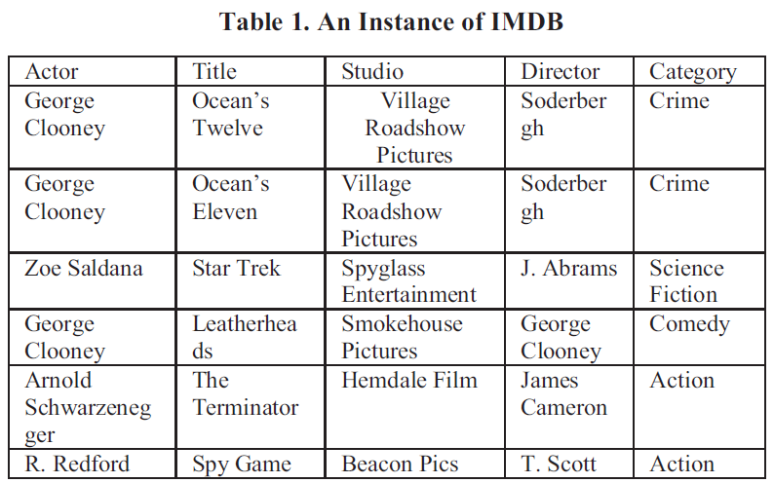
Introduction
Database (EX：IMDB)
The movie(s) which are directed and stared in by George Clooney
“Movie” OR “directed” OR “starred” OR “George” OR “Clooney”
“Movie” AND “directed” AND “starred” AND “George” AND “Clooney”
Not found

Slide 5
Introduction
Database (EX：IMDB)
The movie(s) which are directed and stared in by George Clooney
Director / Actor
Search Result：
Movie : Leatherheads
Actor : George Clooney
Director: George Clooney

Slide 6
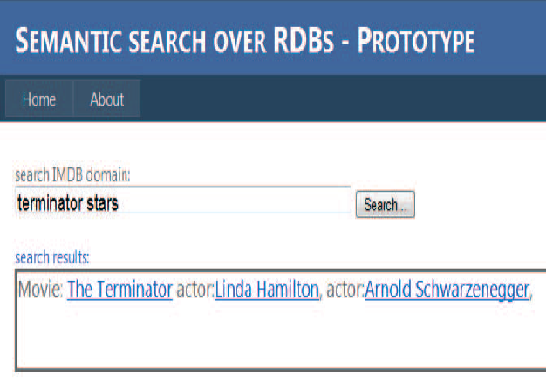
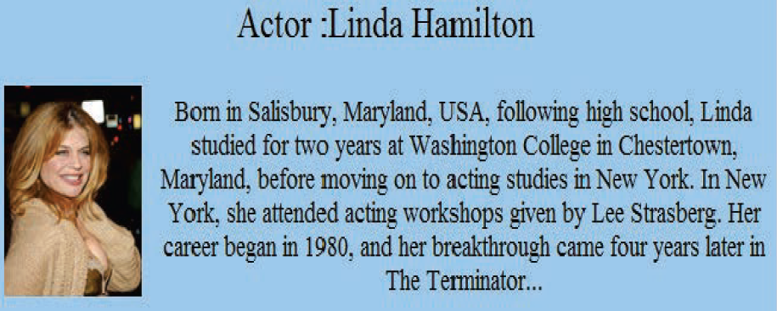
The UI of the System

Slide 7
Outline
Introduction
DBSemSXplorer’s System Architecture
Relational database to RDF
Knowledge Base
Extracting an ontology from the database schema
Query Keyword to Knowledgebase Resource Mapper
Keyword mapping Techniques
SPARQL Query Construction
Experiment
Conclusion

Slide 8
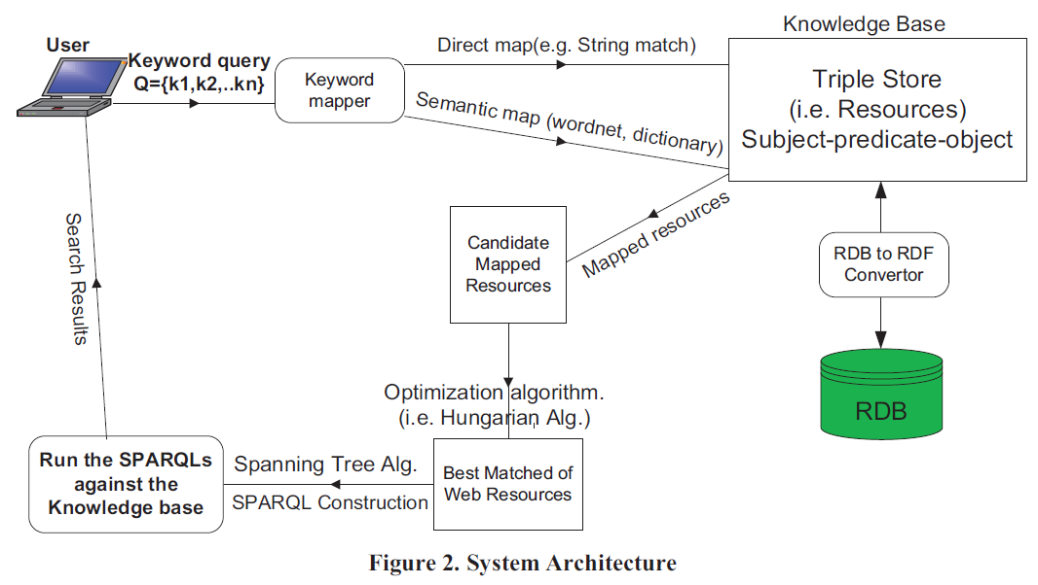
System Architecture
Keyword to Knowledgebase
Resource Mapper
1
Knowledge Base Generation
2
SPARQL Query Construction
3

Slide 9
Outline
Introduction
DBSemSXplorer’s System Architecture
Relational database to RDF
Knowledge Base
Extracting an ontology from the database schema
Query Keyword to Knowledgebase Resource Mapper
Keyword mapping Techniques
SPARQL Query Construction
Experiment
Conclusion

Slide 10
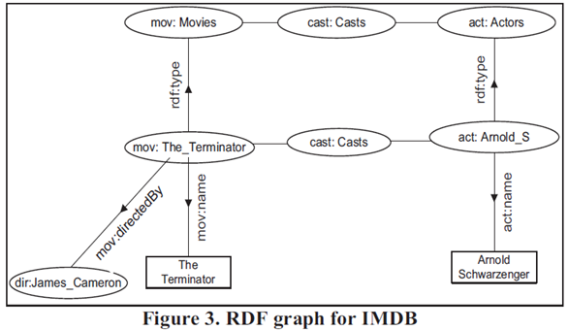
Knowledge Base
RDB
RDF
Notes:
資源描述框架（Resource Description Framework，簡稱RDF），是全球資訊網聯盟提出的一組標記語言的技術標準，以便更為豐富地描述和表達網路資源的內容與結構
其語法可簡單的用「A有一個B是C來表示」，強調該陳述的各個部分是為了強調：
陳述所描述的事物：(A) 。
陳述所描述事物的具體屬性（property）：(B) 。
陳述所描述的作為該屬性（陳述所描述事物對應的）的值的事物：(C)。

Slide 11
Outline
Introduction
DBSemSXplorer’s System Architecture
Relational database to RDF
Knowledge Base
Extracting an ontology from the database schema
Query Keyword to Knowledgebase Resource Mapper
Keyword mapping Techniques
SPARQL Query Construction
Experiment
Conclusion

Slide 12
Extracting an ontology from the database schema
Movie
Directors
Movie ID | Title | DirectorID
1 | Ocean’s Twelve | 001
2 | Star Trek | 004
3 | Leatherheads | 003
4 | The Terminator | 002
DirectorID | Direct
001 | Soderbergh
002 | James Cameron
003 | George Clooney
004 | J.Abrams

Slide 13
Extracting an ontology from the database schema
Movie
Directors
Movie ID | Title | DirectorID
1 | Ocean’s Twelve | 001
2 | Star Trek | 004
3 | Leatherheads | 003
4 | The Terminator | 002
DirectorID | Direct
001 | Soderbergh
002 | James Cameron
003 | George Clooney
004 | J.Abrams
Movie , 1
Movie: title
Ocean’s Twelve

Slide 14
Extracting an ontology from the database schema
Movie
Directors
Movie ID | Title | DirectorID
1 | Ocean’s Twelve | 001
2 | Star Trek | 004
3 | Leatherheads | 003
4 | The Terminator | 002
DirectorID | Direct
001 | Soderbergh
002 | James Cameron
003 | George Clooney
004 | J.Abrams
Movie , 1
Movie: title
Ocean’s Twelve
Movie: DirctorID

Slide 15
Extracting an ontology from the database schema
Movie
Directors
Movie ID | Title | DirectorID
1 | Ocean’s Twelve | 001
2 | Star Trek | 004
3 | Leatherheads | 003
4 | The Terminator | 002
DirectorID | Direct
001 | Soderbergh
002 | James Cameron
003 | George Clooney
004 | J.Abrams
Movie , 1
Movie: title
Ocean’s Twelve
Movie: title
Director, 001
Directors: Direct
Soderbergh
Scanning each table row by row. Each row of a table which is identified uniquely by a primary key becomes a subject of a triple

Slide 16
Outline
Introduction
DBSemSXplorer’s System Architecture
Relational database to RDF
Knowledge Base
Extracting an ontology from the database schema
Query Keyword to Knowledgebase Resource Mapper
Keyword mapping Techniques
SPARQL Query Construction
Experiment
Conclusion

Slide 17
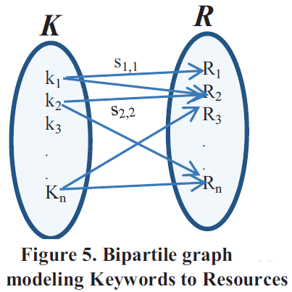
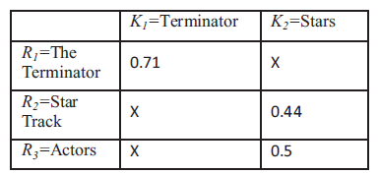
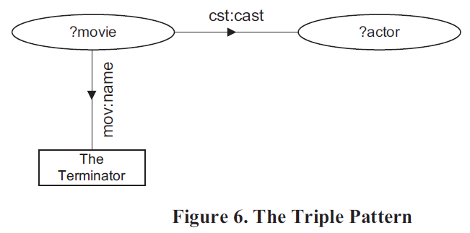
Keyword Mapping Techniques
Q = {Terminator , Stars}
Q = {Terminator , Stars}
Terminator → “The Terminator”
Stars → “Star Track” , “Actors”

Slide 18
Keyword Mapping Techniques
Q = {Terminator , Stars}
Terminator / stars
The Terminator / Actors
(Similarity)
Semantic Mapping (WordNet)
Levenshtein distance (Edit Distance)
Computing the syntactic similarity between each ( 1.terms and 2.phrase ) and each resource in the knowledgebase
Tokenize the query string into N individual terms (Unigram)
Generate a set of 2-term phrases/nouns from the query string (Bigram)

Slide 19
Keyword Mapping Techniques
Q = {scary movie stars}
Unigram : “scary” , “movie”, “stars”
finding the “stars” who have starred in scary movies.
Bigram : “scary movie” , “movie star”
finding the “stars” of the movie called “scary movie”
Choosing 0.4 as a threshold
Looking up each query keyword in a dictionary (e.g. WordNet) to find the semantically similar resources for that keyword, which if found will be added to with a score of 0.5,

Slide 20
Similarity
T H E Terminator → The Terminator (insertion of ‘T‘ , ‘H‘ , ‘E‘ at the front)
LevenshteinDist ( “Terminator” , “The Terminator ”) = 3
Similarity ( “Terminator” , “The Terminator ”)
= 1 - $\frac{3}{13} \text{=}\text{ 0.769}$ > 0.4

Slide 21
Outline
Introduction
DBSemSXplorer’s System Architecture
Relational database to RDF
Knowledge Base
Extracting an ontology from the database schema
Query Keyword to Knowledgebase Resource Mapper
Keyword mapping Techniques
SPARQL Query Construction
Experiment
Conclusion

Slide 22
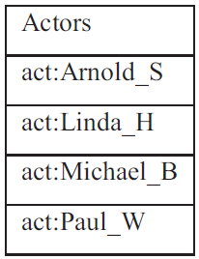
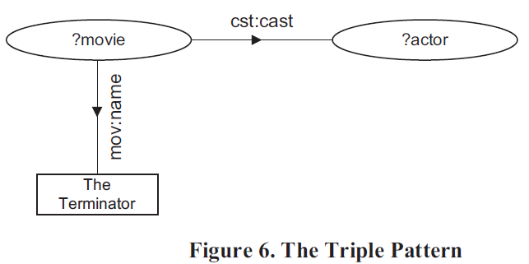
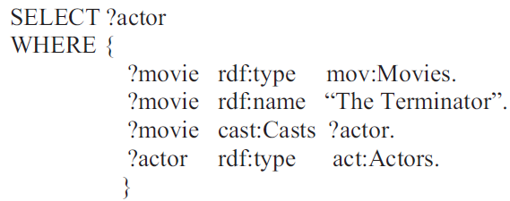
SPARQL Query Construction
Q = {Terminator , Stars}

Slide 23
SPARQL Query Construction
Q = {Terminator , Stars}

Slide 24
SPARQL Query Construction
Q = {Terminator , Stars}

Slide 25
Outline
Introduction
DBSemSXplorer’s System Architecture
Relational database to RDF
Knowledge Base
Extracting an ontology from the database schema
Query Keyword to Knowledgebase Resource Mapper
Keyword mapping Techniques
SPARQL Query Construction
Experiment
Conclusion

Slide 26
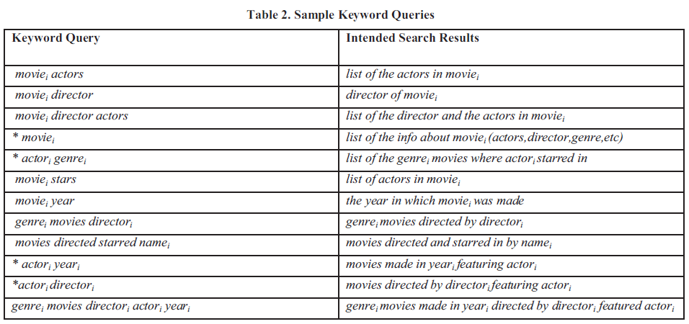
Outline
Type1 keyword : the names of the actors, actresses, studios, etc which are indicated by name_{i} in the table.
Type2 keyword : the actual concepts, relationships (e.g. actor, director, starred in, etc).

Slide 27
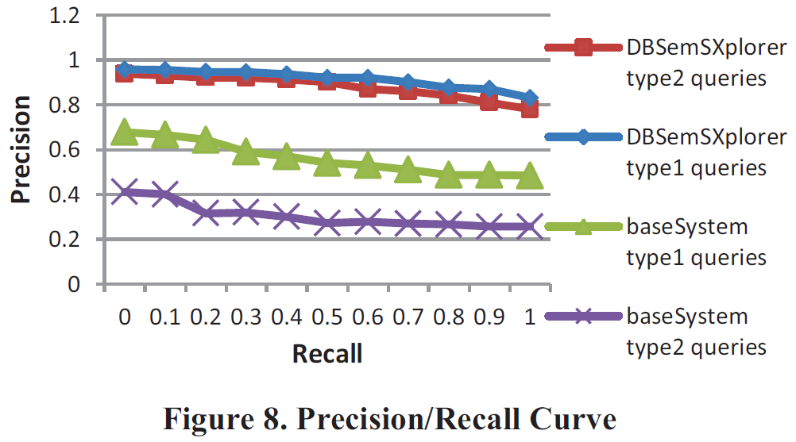
Experiment

Slide 28
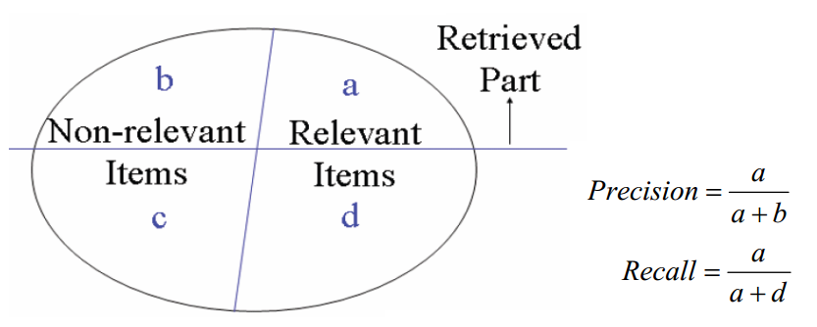
Precision , Recall
Total : 1000
＝ 100
＝ 400
＝ 300
＝ 200
Precision = $\frac{400}{100+400}$= $\frac{400}{500}$ = 0.8
Recall = $\frac{400}{400+200}$= $\frac{400}{600}$ = $0.67$

Slide 29
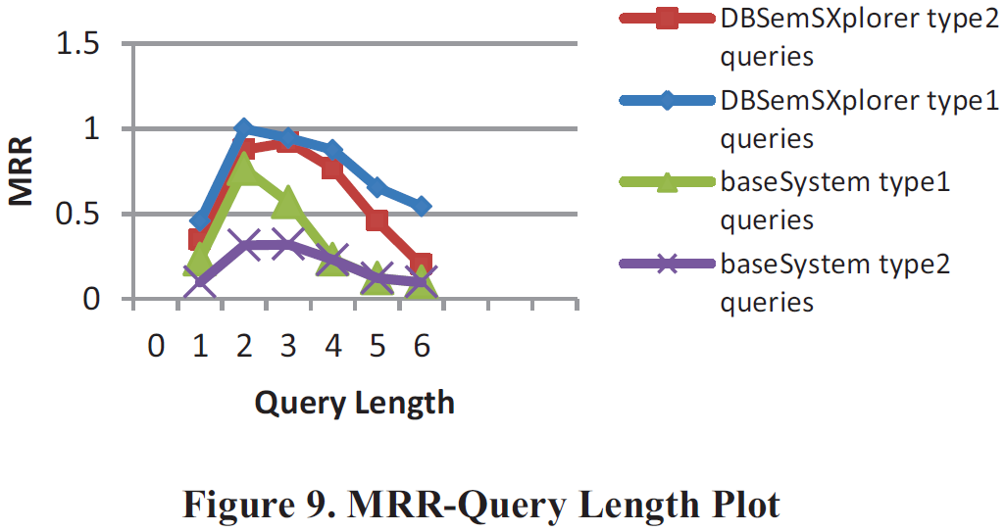
Experiment
Notes:
此評估法分數越高表示，系統越能在前幾個答案中便回答問題

Slide 30
Mean Reciprocal Rank (MRR)
Query
Query 1
Query 2
Query 3
Query 4
Query 5
Ranking
Result
1.
2.
3.
4.
5.
1.
2.
3.
4.
5.
1.
2.
3.
4.
5.
1.
2.
3.
4.
5.
1.
2.
3.
4.
5.
1/2 1 1 1/4 1/3
Reciprocal
Rank
MRR = ( $\frac{1}{2}$+ 1 + 1 + $\frac{1}{4}$ + $\frac{1}{3} )$
/ 5 = 0.617
Notes:
此評估法分數越高表示，系統越能在前幾個答案中便回答問題
n為問題個數，rank(qi)表示系統第一個正確回答問題qi的答案排行(answer rank)。
假如系統在第2 個排行正確回答了問題，則這問題的分數為1/2，最後計算問題的平均分數即可。
如果系統最後的MRR 值為0.5，表示此系統平均在第二的答案中即可回答正確答案

Slide 31
Outline
Introduction
DBSemSXplorer’s System Architecture
Relational database to RDF
Knowledge Base
Extracting an ontology from the database schema
Query Keyword to Knowledgebase Resource Mapper
Keyword mapping Techniques
SPARQL Query Construction
Experiment
Conclusion

Slide 32
Conclusion
This paper proposed an approach and implemented a system based on that, DBSemSXplorer, to answer keyword search in RDBs by
Transforming the RDBs into an RDF knowledgebase
Mapping the query terms into the most semantically and syntactically similar knowledgebase resources
Constructing equivalent SPARQL from the mapped terms
Paper’s approach outperformed the previous approaches in finding the most relevant answers to the keyword query.

